Slide 1

Shop the Change
Usability Testing Report
Antonio Eggermont, Kaiyue Fan, Cally Smith, Jenny Vogel
HCDE 517, March 2019

Slide 2
Table of Contents
Executive Summary………………………………………………….4
Overview……………………………………………………………....6
Methods and Procedures…………………………………………..13
Findings……………………………………………………………....19
Recommendations…………………………………………………..30
Reflection & Learnings……………………………………………...37
Appendix……………………………………………………………...40

Slide 3
Executive Summary
A group of graduate students from Human Centered Design and Engineering department at the University of Washington conducted a usability study on behalf of a company named Shop the Change, to test the usability of their beta website.
Shop the Change is an online marketplace where users gain instant access to transparent information about the companies behind their shopping lists. The website includes product search, product and cause details, a shopping list to save products.
With the objectives of (1) identifying usability issues in core features that might stop users from using the app, and (2) exploring possible changes to the site and/or its content to improve user experience and increase user attraction & adoption, market research, a competitive analysis, and a remote usability study with 7 participants was executed.
The following is a summary of our findings and recommendations.

Slide 4
Executive Summary Contd.
Findings
Users had a hard time finding products that reflect their values
Users didn’t have sufficient information to accomplish a purchase decision
Users liked the site’s value and simplicity, but had trouble understanding purpose
Users are more likely to use a mobile app in store than at home
Recommendations
Improve UI to highlight the key functions and add interactive tutorials which show users how to interact with the site when users first login
Improve navigation by adding filtering by brands & categories, add auto-complete and recommendation to search
Change “shopping list” to “my favorites”. “Shopping list” made users think they could purchase immediately, whereas they wanted to just save the products for reference
Add product comparison
On product detail page, add a short summary for the highlights section in addition to the scores

Slide 5
Overview

Slide 6
About the Product
Shop the Change is an online marketplace where users gain instant access to transparent information about the companies behind their shopping lists.
At-a-glance, they will see which brands align with with causes they care about (linked easily to supporting data), add items to a shopping list, and purchase online via affiliate links with selected online retailers.
Their MVP causes include Racial Equality, Women’s Rights, Non-Exploitation, Environmental Responsibility, Humane Farming, LGBTQ+ Rights, and Vegan.

Slide 7
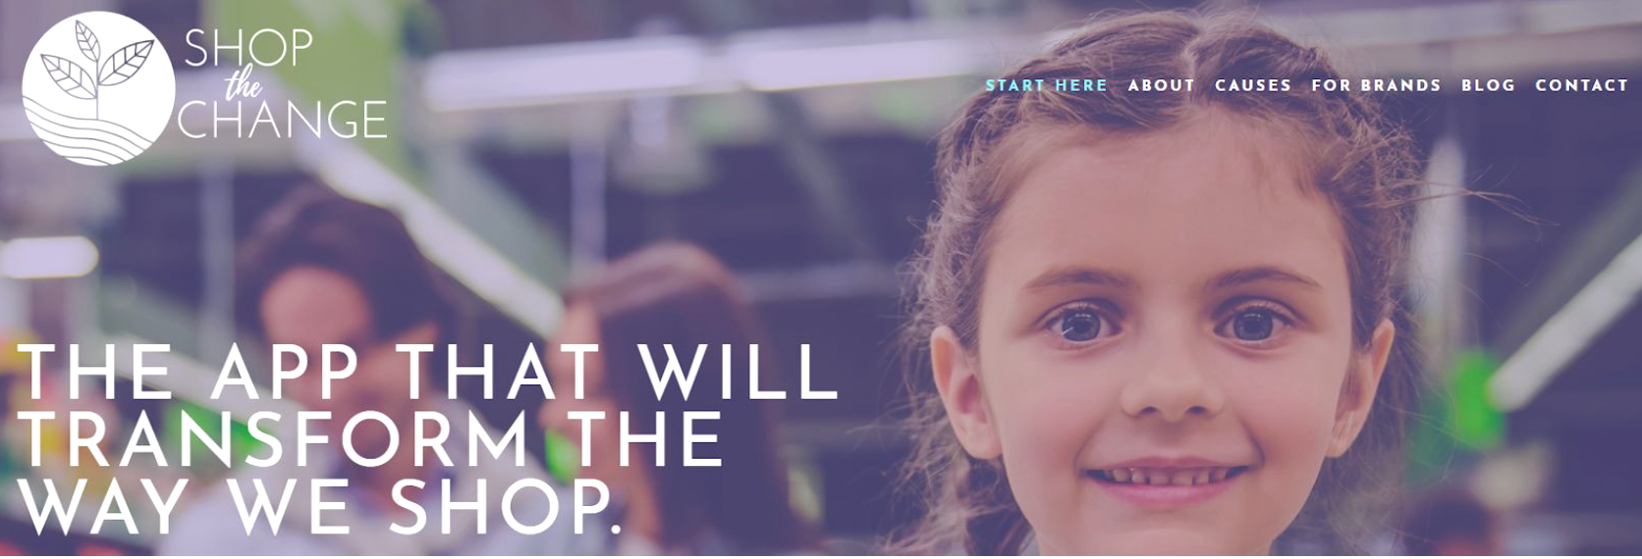



Slide 8
Study Objectives
1
Identify usability issues in core features that might stop users from using the app
Finding products that support certain causes
Grading system & product information
Shopping list functionality
Explore possible changes to the site and/or its content to improve user experience and increase user attraction & adoption
E.g., display of product information, social sharing
2

Slide 9
Target Audience
Potential “early-adopters,” or users who...
✓ Prioritize conscious shopping now, or would if it were easier
✓ Are interested in making purchasing decisions based on company values
✓ Are primarily responsible for purchasing decisions

Slide 10
Research Questions - Original
1
How easily can users shop according to their values using the site?
What do users think the primary purpose of the website should be?
What issues could prevent users from successfully using this site?
How useful do users find the product information?
How will users want to use the shopping list?
2
3
4
5

Slide 11
Research Questions - Evolved
Based off themes that materialized during the first few sessions, we narrowed our primary research questions
1
Can users find products to purchase that align with their values?
How will users integrate the site into their current shopping habits?
Do users have enough information in order to make purchasing decision?
2
3

Slide 12
Methods and Procedures

Slide 13
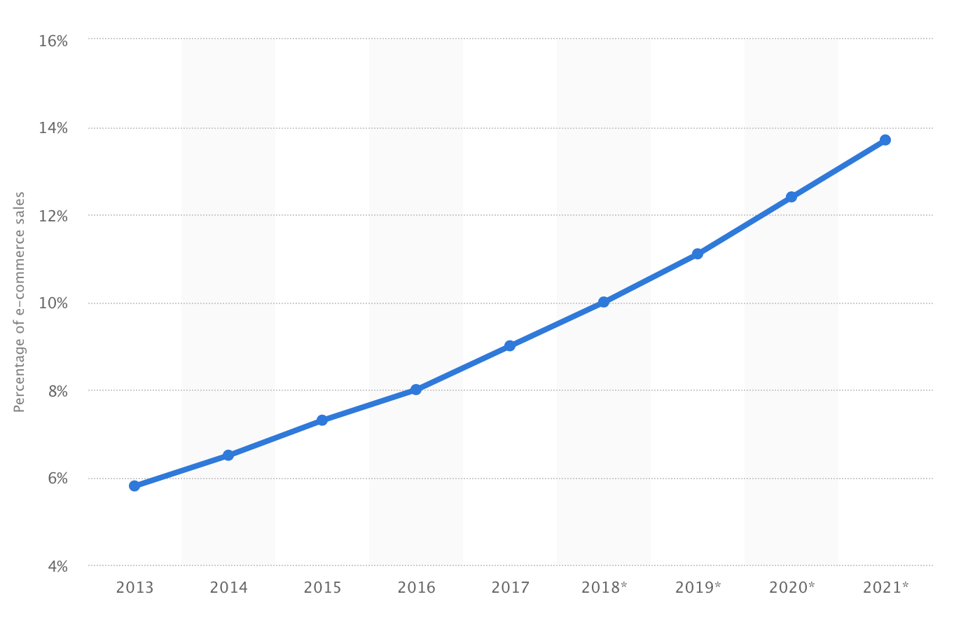
Market Research
People tend to shop online more often
E-commerce share of total retail sales in United States from 2013 to 2021

Slide 14
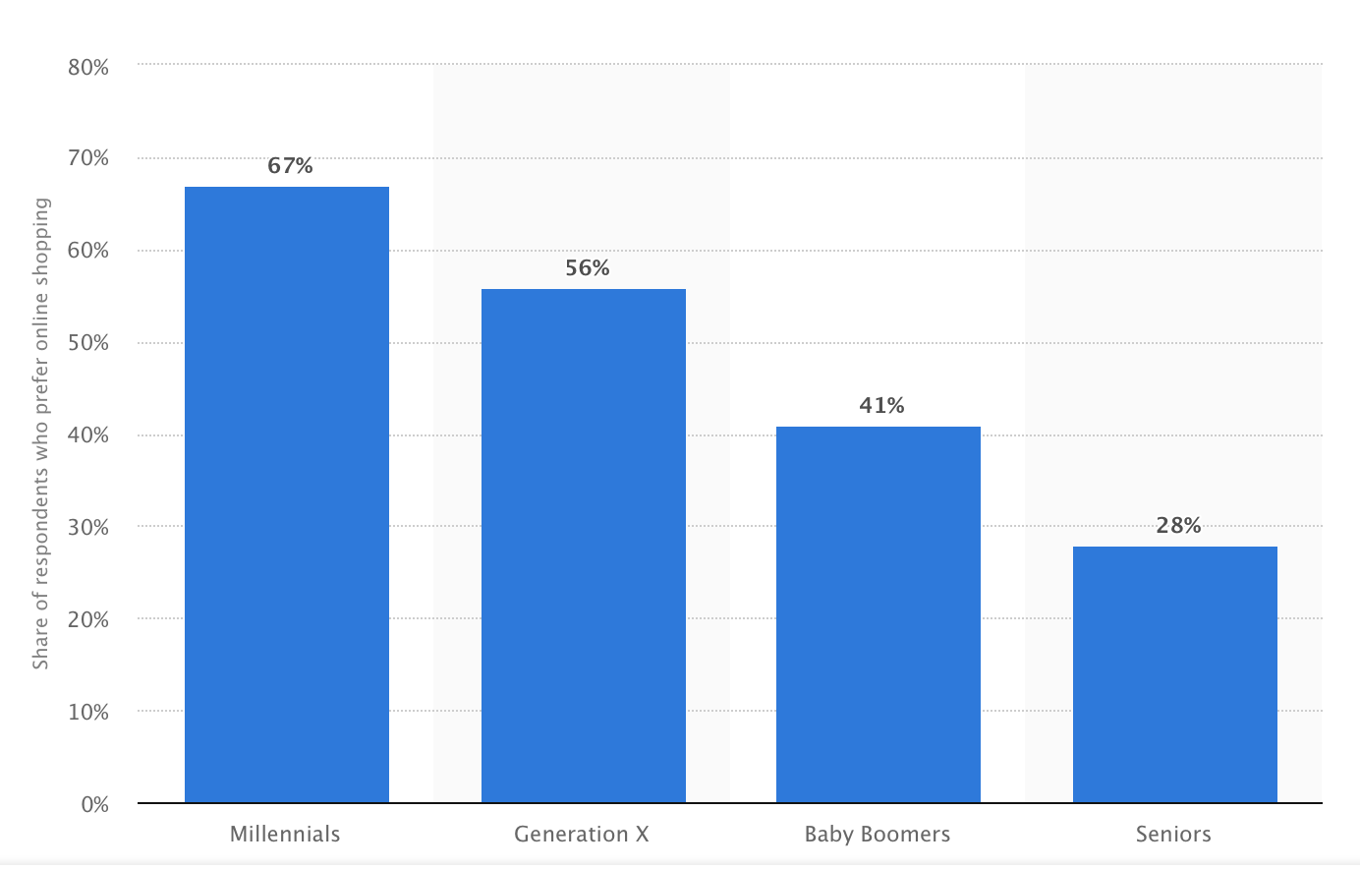
Market Research
Millennials consist the biggest group of online shoppers
Online shopping preference in the United States as of 2017, by age group

Slide 15


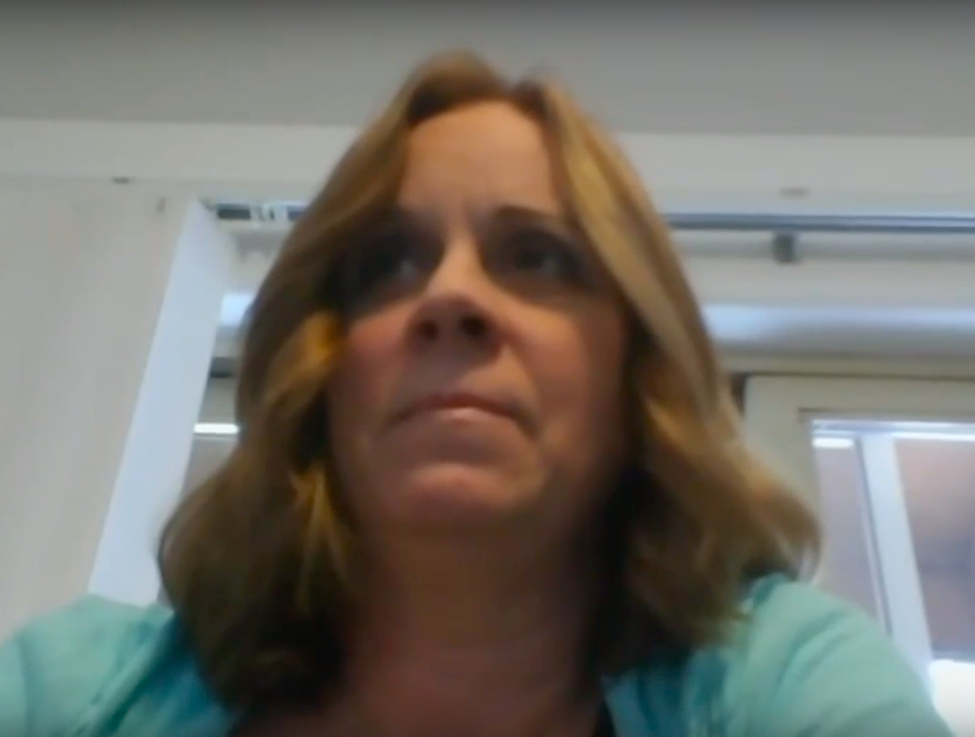




Participant Profile
Who
7 participants, 5 female / 2 male, all entirely new to the STC app
Strong interest in making purchasing decisions based on company values
At least partially responsible for making the purchasing decisions in their household

Slide 16
Participant Profile
 | Age | Gender | House Size | Residence | Work | Shopping List Apps | Top Causes
P1 | 24 | Female | 4 | WA D.C. | Business/Tech | Google Docs | Women's Rights, Racial Equality, Enviro Responsibility
P2 | 27 | Male | 2 | Rochester, NY | Optometry | Evernote, iOS Note | Women's Rights, Racial Equality, Environmental Responsibility
P3 | 54 | Female | 3 | Olalla, WA | Elementary Teacher | N/A | Environmental Responsibility
P4 | 28 | Female | 3 | Seattle, WA | Copywriting | iOS Note | Women's Rights, Environmental Responsibility, Humane Farming
P5 | 27 | Female | 1 | Jacksonville, FL | Guidance Counsellor | iOS Note | Racial Equality, LGBTQ+, Enviro Responsibility
P6 | 29 | Female | 2 | Lake Mary, FL | Recruiter | Google Docs | Women's Rights, Racial Equality, Enviro Responsibility
P7 | 29 | Male | 1 | Ottawa, Canada | Store Clerk | Evernote | Women's Rights, Racial Equality, Enviro Responsibility

Slide 17
Methods and Procedures
Where
Remote video sessions using Zoom video conferencing software
Methods
✓ Google form pre-test questionnaire
✓ Moderated tasks & Think Aloud Method
✓ Pre- & post-test questions & USE scale
✓ Observational notes
✓ Audio/video recording
Data Collected
Qualitative → general feedback, recorded reactions (audio/video), observational notes, pre- & post-test interview responses
Quantitative → USE scores, task completion, task success

Slide 18
Findings

Slide 19
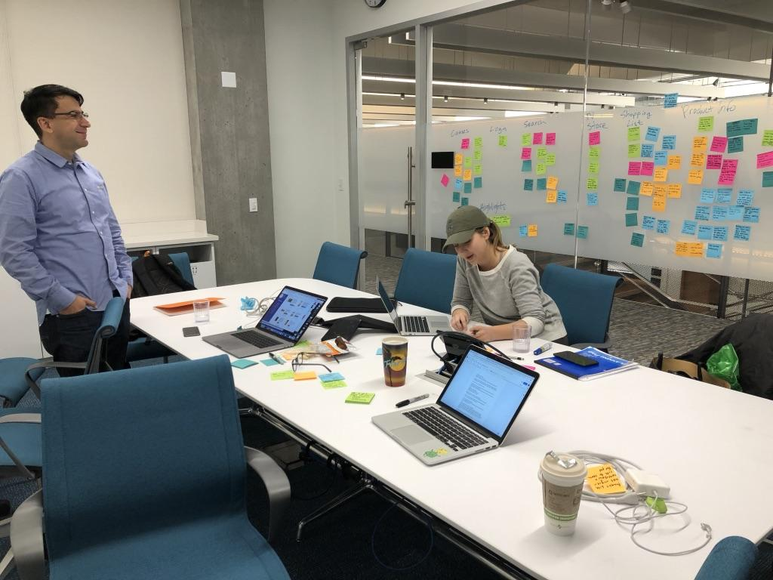
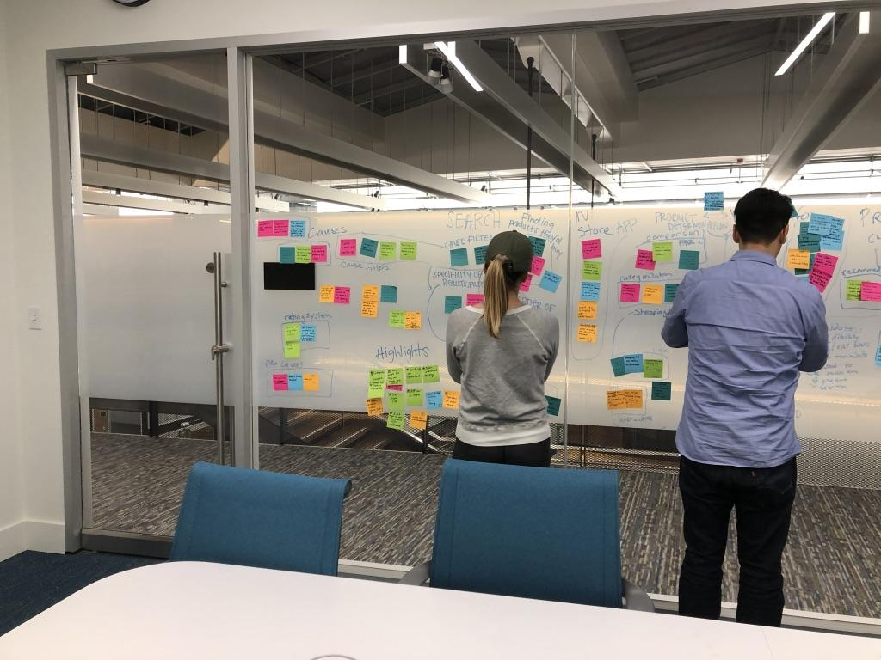
Findings

Slide 20
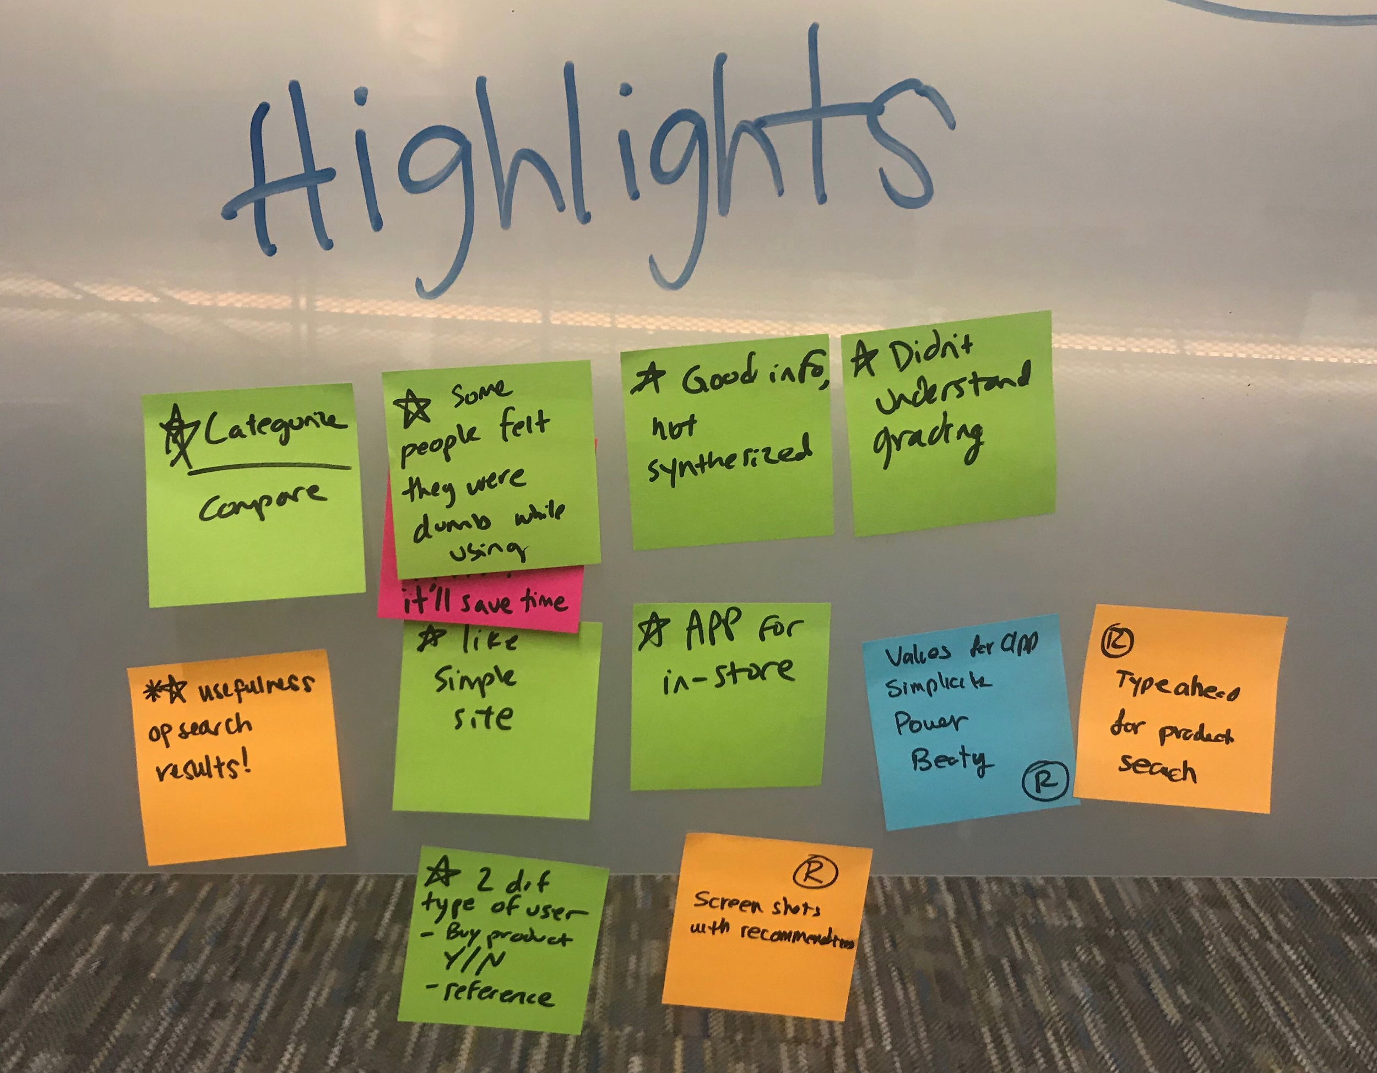

Slide 21

Users had a hard time finding products that reflect their values
6/7 participants found it confusing to understand and use cause filters
7/7 participants couldn’t understand rating system criteria
5/7 participants expressed it’s hard to find certain brands
"How is a cause (eg. LGBT rights) accomplished by purchasing food?"
"Can I find something with a bad rating?"

Slide 22
Users didn’t have sufficient information to accomplish a purchase decision
6/7 users expressed their wish for products to be better categorized by cause values, gradings, and similar products
5/7 users strongly wanted to be able to compare between products
6/7 users found documentation supporting causes to be helpful, but they would rather have this information synthesized
"It will be helpful to have a little explanation on the cause filters"
"I don’t understand the approved gradings at all"

Slide 23
Users liked the site’s value and simplicity, but had trouble understanding purpose
3/7 participants found it difficult to understand how using the site related to supporting a cause
5/7 were confused by shopping list functionality
5/7 skipped tutorial or did not read closely
"How is a cause (e.g. LGBT rights) accomplished by purchasing food?"
“This is too separate. I’d have to think what I’m going to buy the week before.”
“Sounds like you are able to buy online if you want to, but I don’t see option for that here.”
(on shopping list)

Slide 24
Users are more likely to use a mobile app in store than at home
5/7 participants expressed they would like to check the products in store and compare info from app
"Can I scan the barcode and check the brand info instantly at store?”

Slide 25
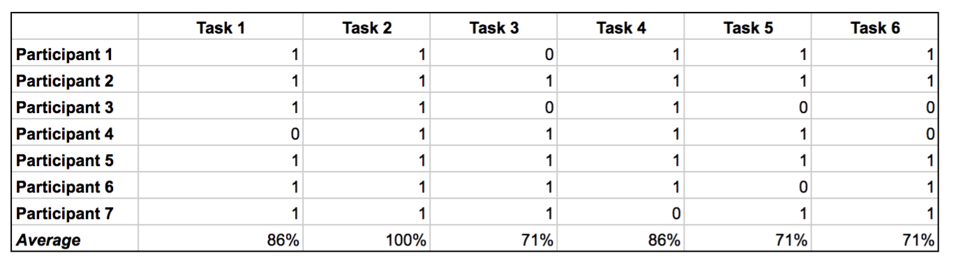
Task Success Data for 7 participants and 6 tasks
Task 1: How easy was for users to identify and find the buttons to filter by causes
Task 2: How easy users found to navigate throughout the product results page
Task 3: Users understanding of the “shopping list” concept
Task 4: How easy was for users to add multiple items to the shopping list based on a certain cause(s)
Task 5: How easy was for users to remove one or more items from the shopping list
Task 6: How easy was for the user to find brand information with causes she/he cars about for a given product(s)

Slide 26
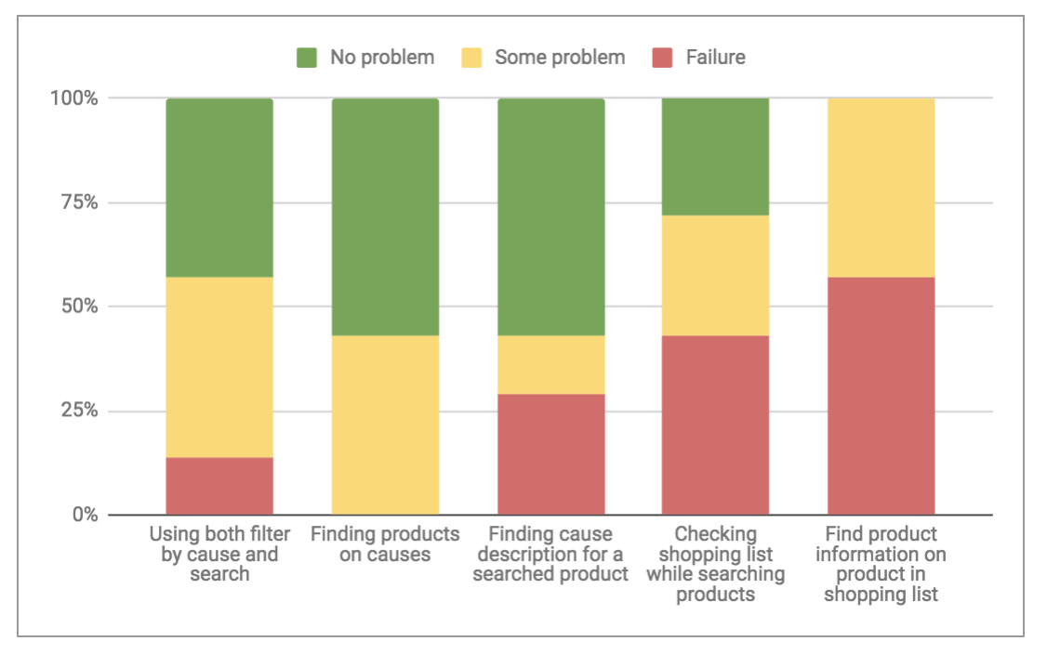
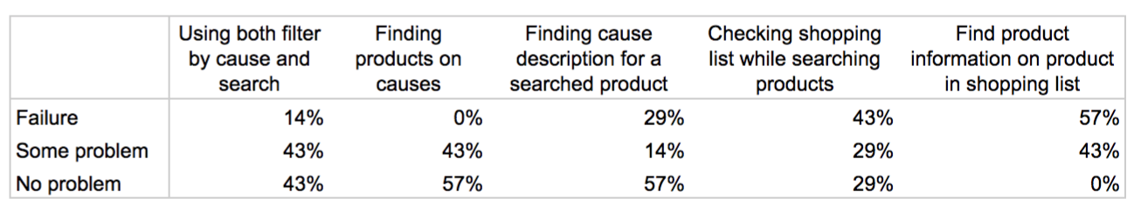
Levels of success by task for 7 participants and 5 tasks

Slide 27
Market Research
80% of millennials’ purchases are highly driven by price.
Other factors that millennials care about are: authenticity, local sourcing, ethical production and a great shopping experience.
60% of millennials want their purchases to make them feel good.
50% of millennials are willing to pay extra for great shopping experience.

Slide 28
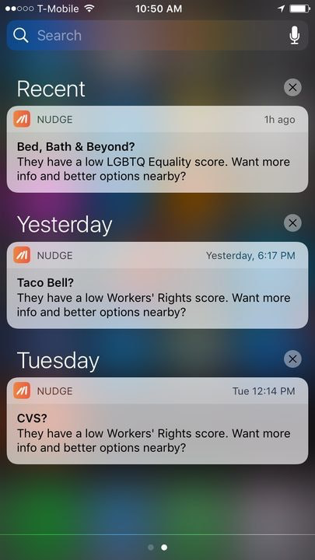
Competitive Analysis - Nudge for Change
It’s a moblie app that tells you where not to shop, based on your value.
Send alerts to you when you are about to purchase in a place that doesn’t align with your value.
The list of preferences includes LGBTQ+ equality, gender equality, racial equality, sustainability and worker's rights.

Slide 29
Recommendations

Slide 30
Overall Goals
Empower the user interface with beauty and simplicity, elevate shopping experience.
Enhance user experience with more clear wayfinding system.
Provide users with more product information in addition to values to help make better purchase decision.

Slide 31
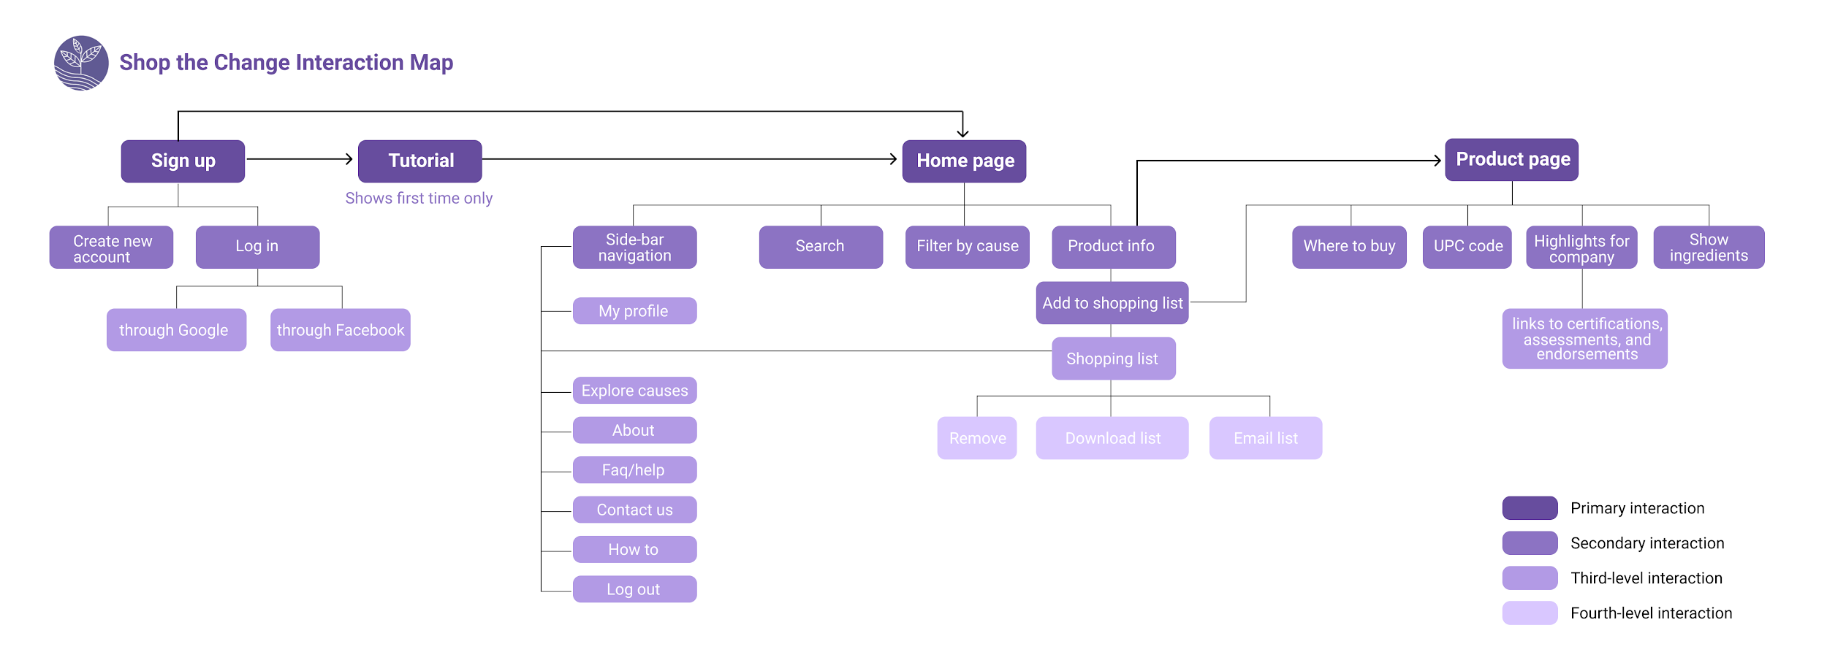
Possible Improvement Areas

Slide 32
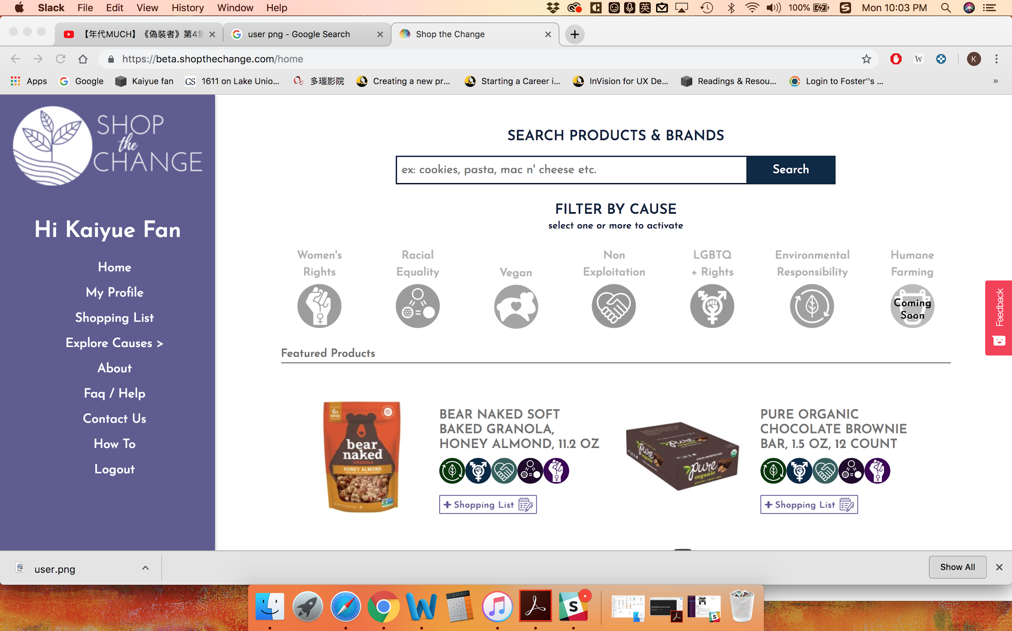
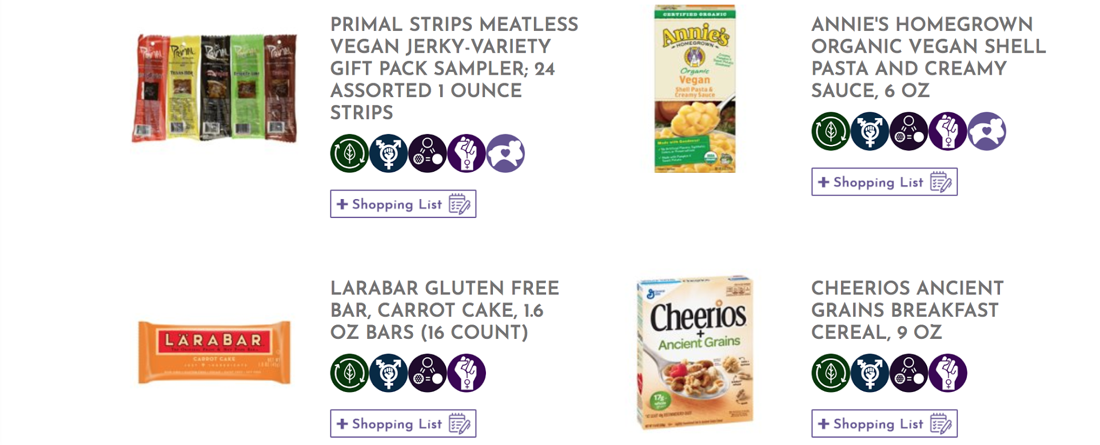
More Intuitive UI
+ Interactive Tutorials
Highlight the key functions and show users how to interact with the site when users first login.

Slide 33
Navigation & Search
Add brands & categories in search bar
Add auto-complete + recommendation for search function
Simplify the categories

Slide 34
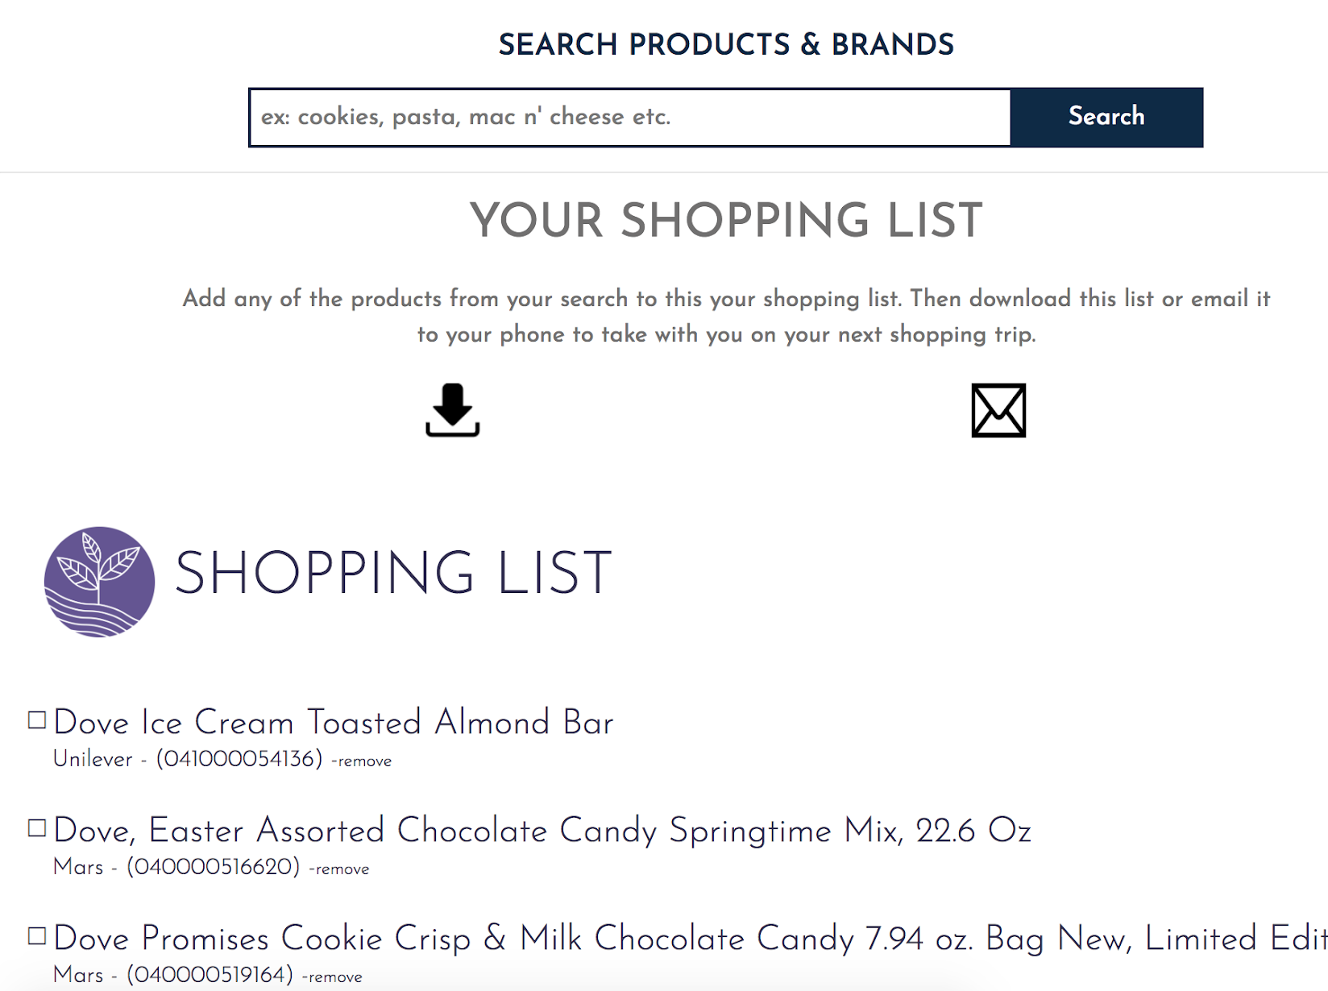
Shopping list page
Change “shopping list” to “my favorites” -- People wanted to just save the products
Add categories to the list

Slide 35
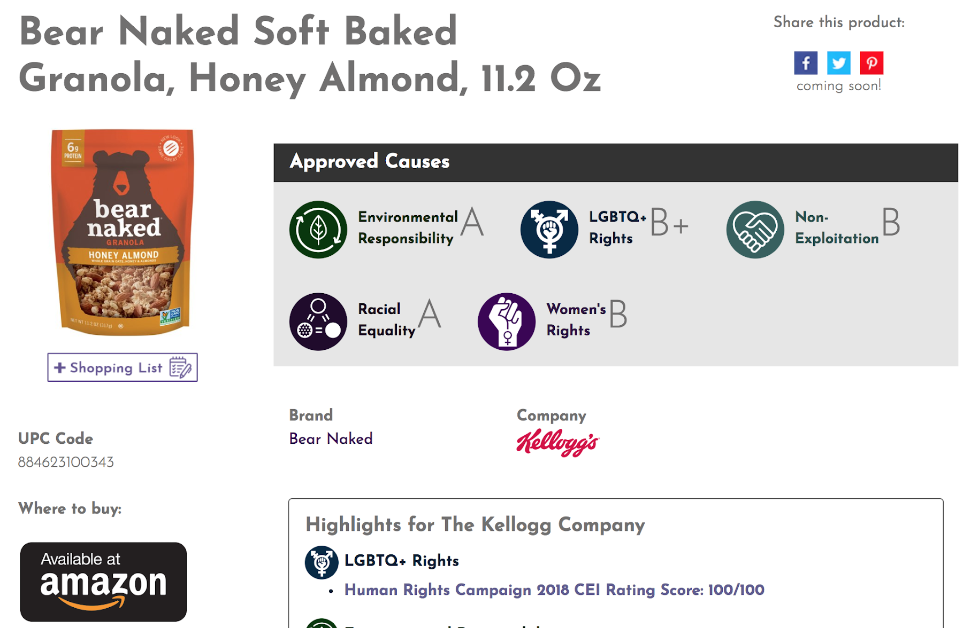
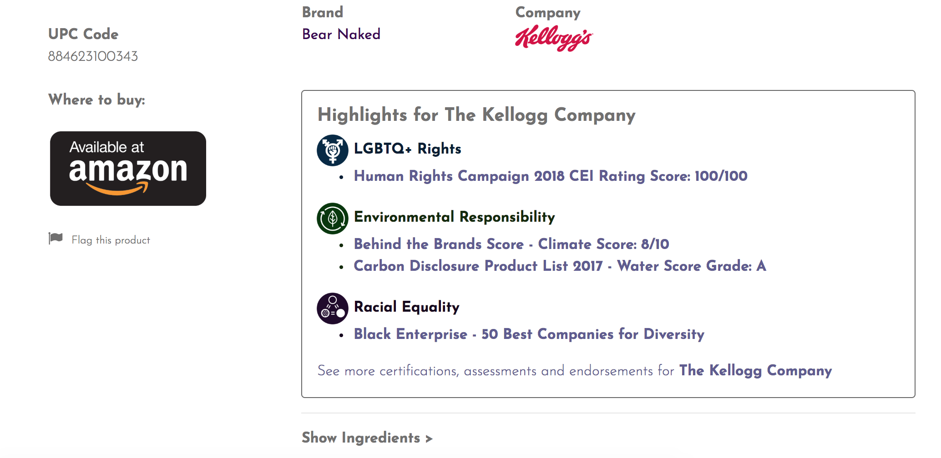
Product page
Add a short brief for what each grade (A, B+, B, etc.) stands for
Add a short summary for the highlights section in addition to the scores to provide users with more qualitative information.
Add products comparison information(price etc.) among different brands.

Slide 36
Reflection & Learnings

Slide 37
What We Learned
Narrow research questions early
When doing a pilot, include session sign-up materials and instructions
Build in time for technical difficulties
If sharing participant scheduling responsibilities, make sure all project team members have access to schedule and participant contact info

Slide 38
Recommendations & Next Steps
What worked?
Participants, researchers, and stakeholders liked remote study format
Uncovered a huge amount of feedback, several participants were very insightful
What could be improved?
Large amount of unfocused data = difficult to disentangle themes
Build in time for technical difficulties
Perform competitive analysis earlier in the process to help inform usability study questions
Possible Changes to Test Plan
Consider removing USE scores or modify to reflect the site’s purpose
Consider more focused sessions on each section of the site
Consider pre-structured tasks such as “imagine you are trying to locate snacks for a party…”
Additional Areas to Explore
Test mobile version of site with people shopping in the store
Exploratory study to focus on user needs for purchasing/shopping list functionalities in-depth
Repeat study with only online shoppers, other user segments
Make suggested changes to site, re-test & compare results

Slide 39
Appendix

Slide 40
Appendix - Links
🔗 Shop the Change Beta Website
🔗 Usability Study Test Kit
🔗 Usability Study Test Plan
🔗 Raw Data Files
🔗 Shop the Change Beta Website
🔗 Usability Study Test Kit
🔗 Usability Study Test Plan

Slide 41
Thank You!

